Slide 1

MATH 170
Introduction to
Scientific Computing
Lecture 1
A. Veneziani
Dept. Math, Dept. CS, Emory

Slide 2
Introduction
Syllabus
Logistics
Motivations
Hardware of a Computer in a Nutshell
Different Languages and Options

Slide 3
SYLLABUS
Let’s have a look at the Syllabus on CANVAS

Slide 4
MOTIVATIONS
What is a computer?
A computer is a tool to perform specific actions, upon instructions
“Instructions” here means a set of operations to do, formulated as an algorithm
This definition is still too vague: we have many tools like that!
An example is an elevator: it does what it is instructed to do with an input interface
What’s special in a computer?
Versatility or, better said: it is programmable
⇒ It can do many things, provided you give it the right instructions…

Slide 5
“Computer”... really?
How do you use a computer?
Watch movies/sports/…
surf internet
play games
Stay in contact with friends
Write documents
…
Do you do any computations?
What kind of computations we may need?

Slide 6
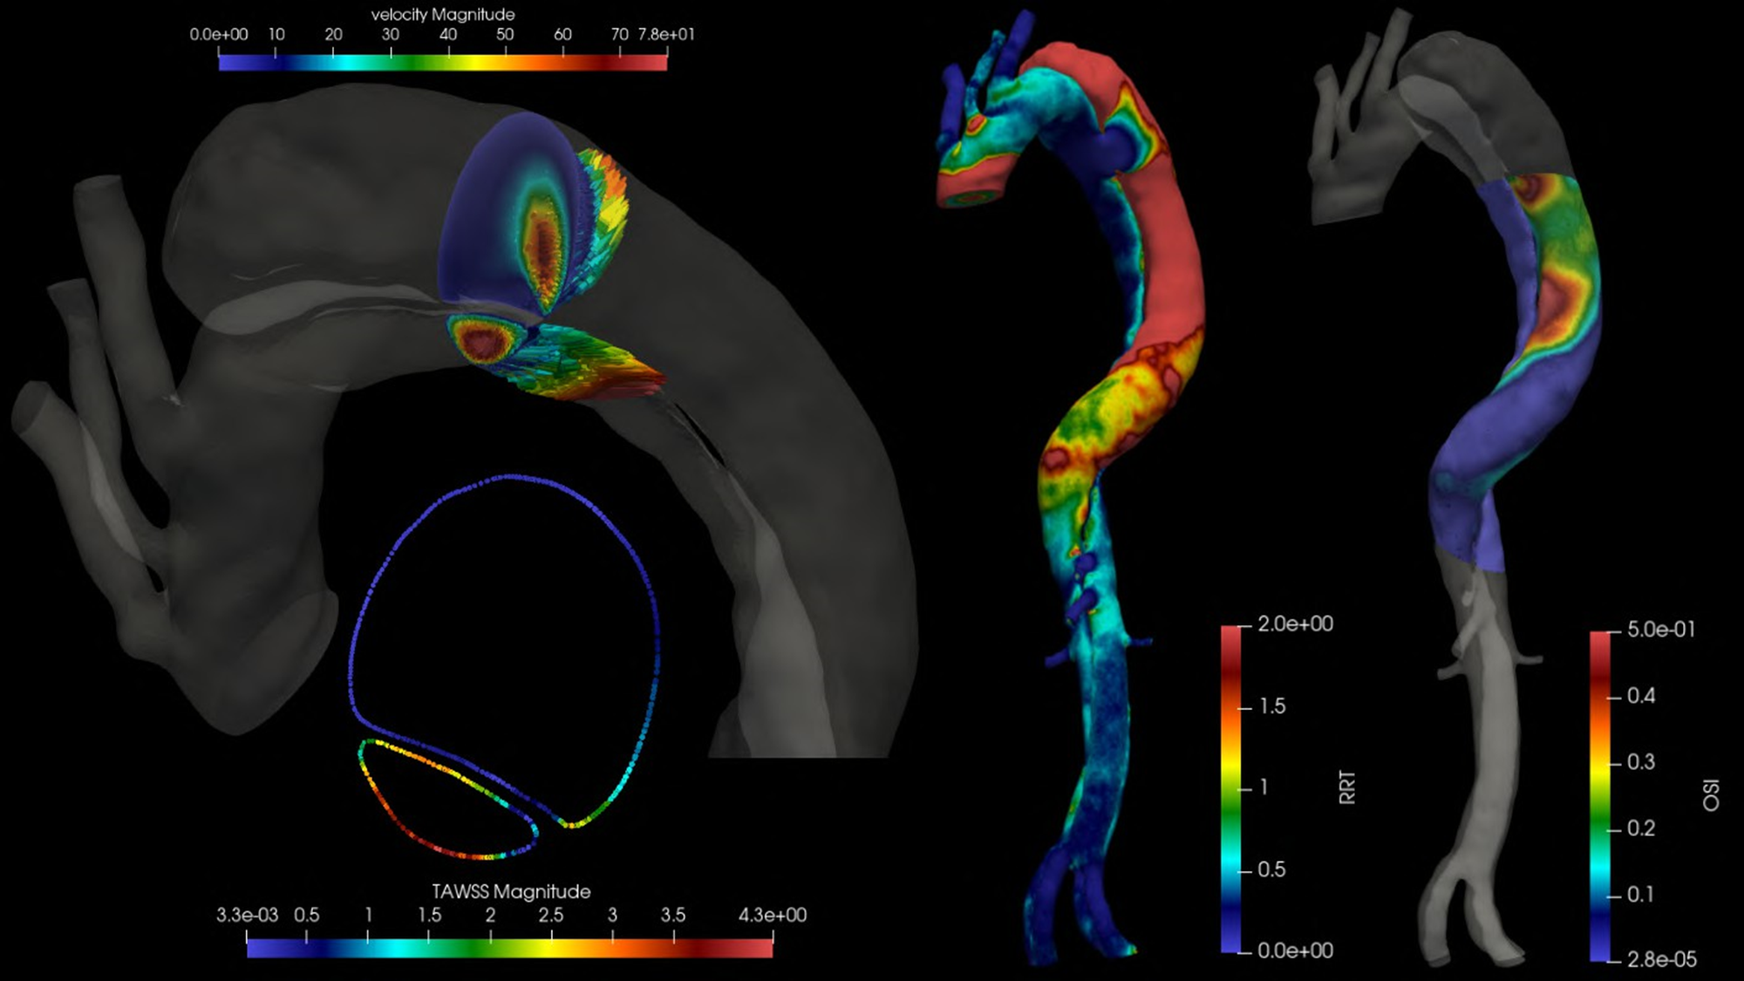
J. Yang

Slide 7
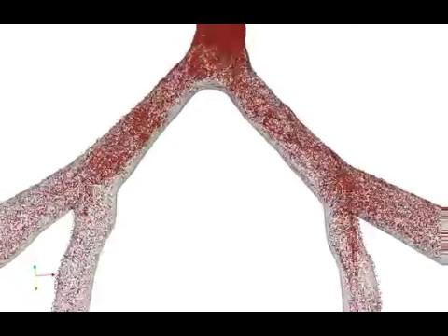

Male Female
T. Passerini, M. Piccinelli

Slide 8
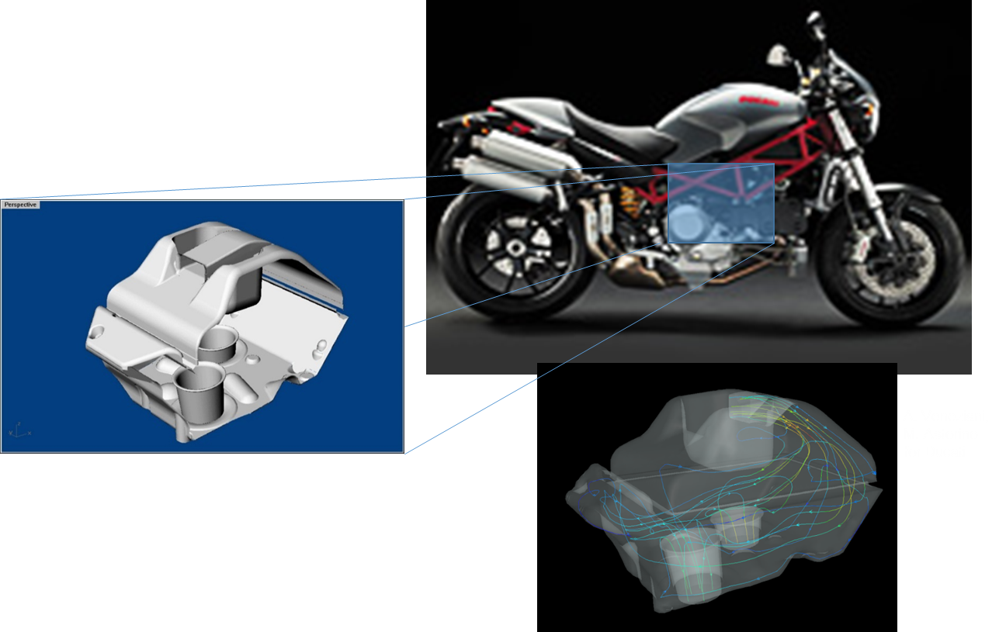

Slide 9
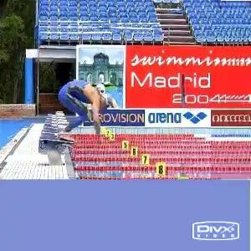
Erika Foa

Slide 10
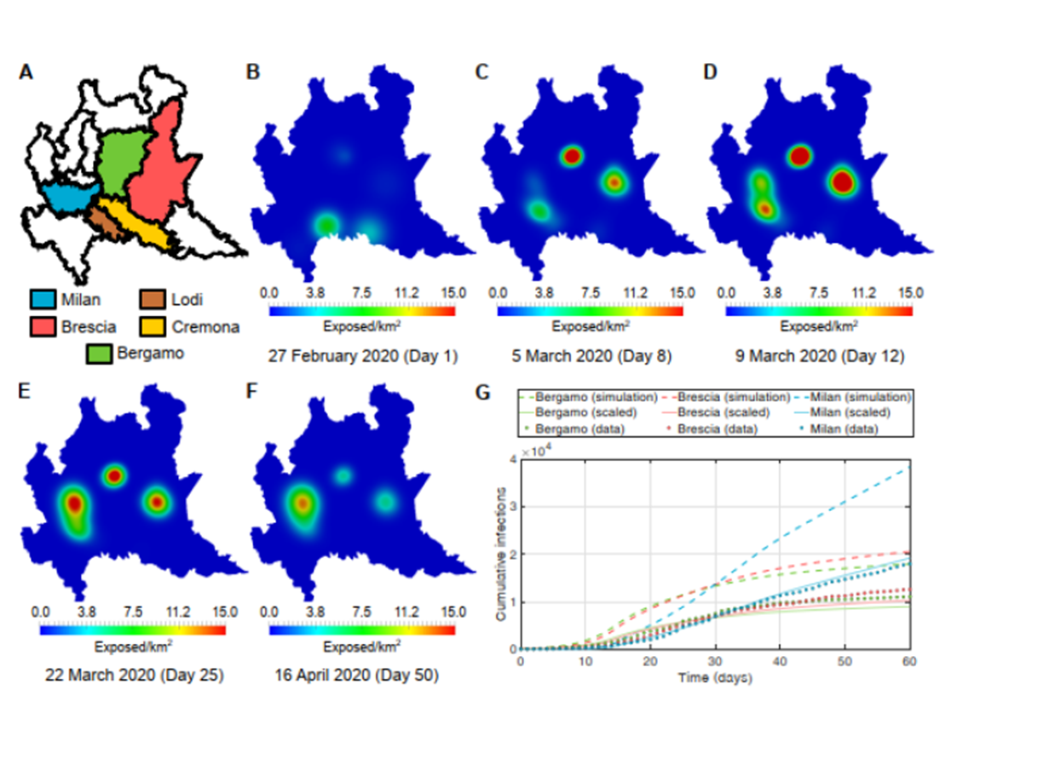
Alex Viguerie

Slide 11
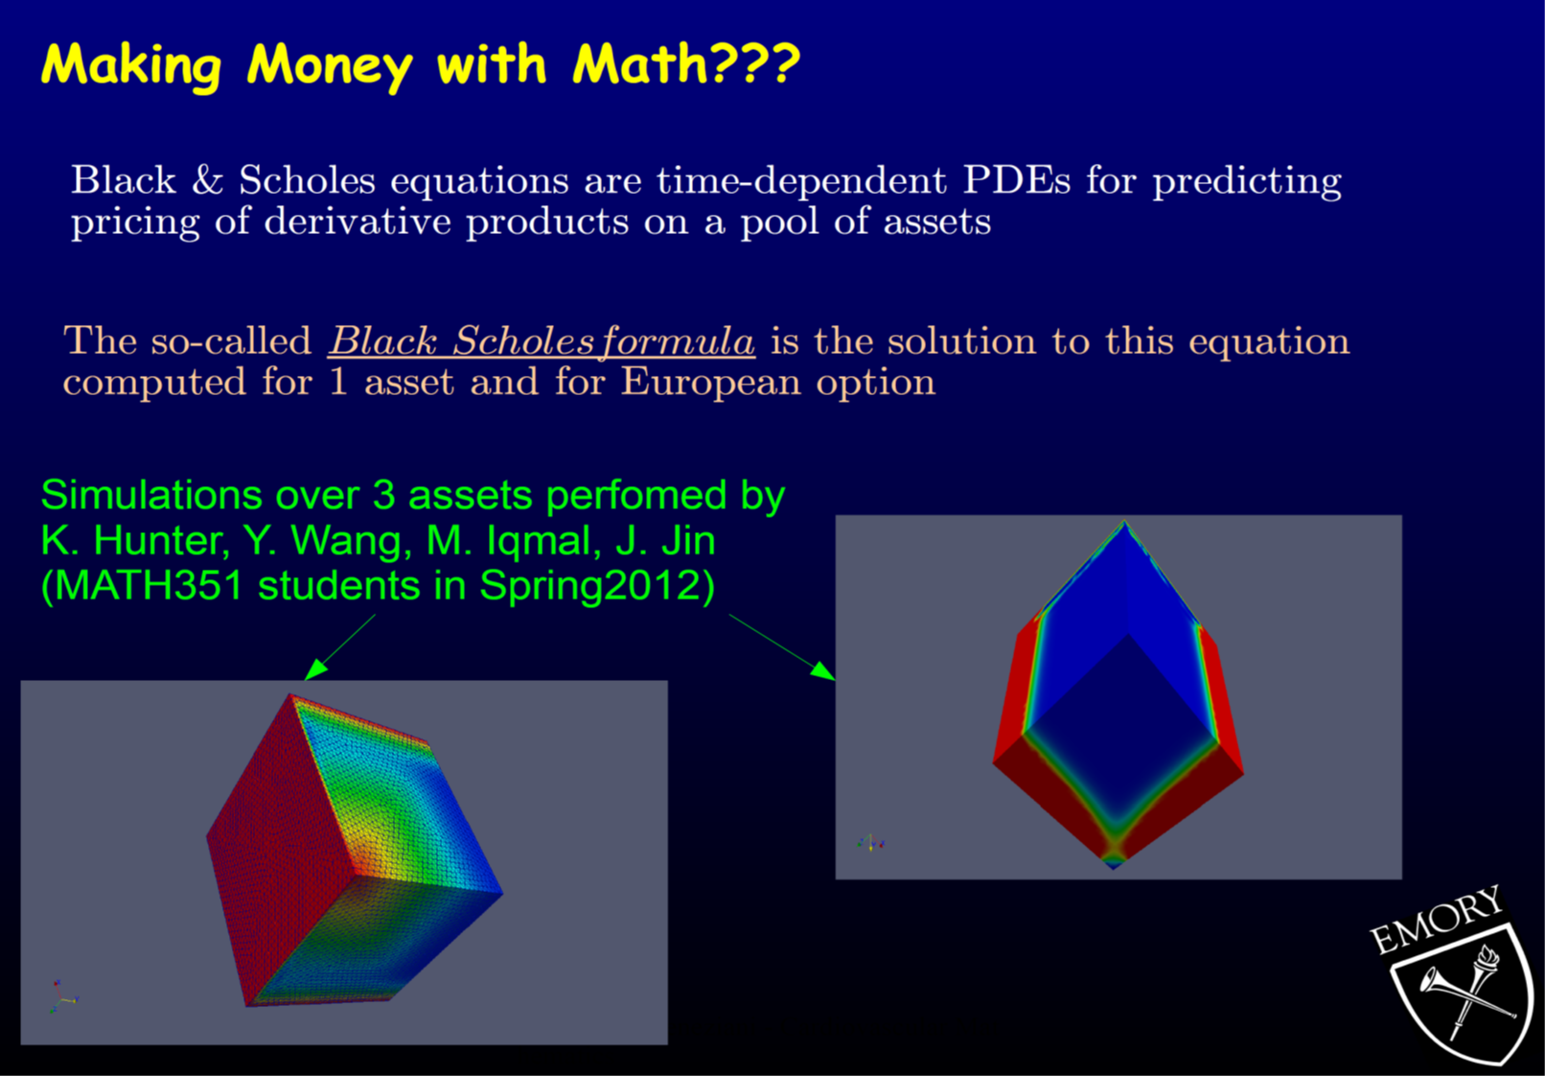

Slide 12
Computations are part of our life
Engineering
Life Sciences
Sports
Medicine
In particular, we consider here what is called “scientific computing”, i.e. solving on a computer scientific problems (raising in any scientific field) with quantitative reasoning.
Scientific computing relies on
Mathematical models
Data
COMPUTERS
How can we do this?

Slide 13
Models: MATH212, MATH221, MATH345, MATH351, PHYSX, BIOX, CHEMX
Methods: MATH315, MATH352, MATH346, MATH347, MATH385
Definitely, you need to communicate with your computer
COMPUTERS:
Hardware: the physical machine
Software: the set of programs, instructions, etc. that tell the computer what to do

Slide 14
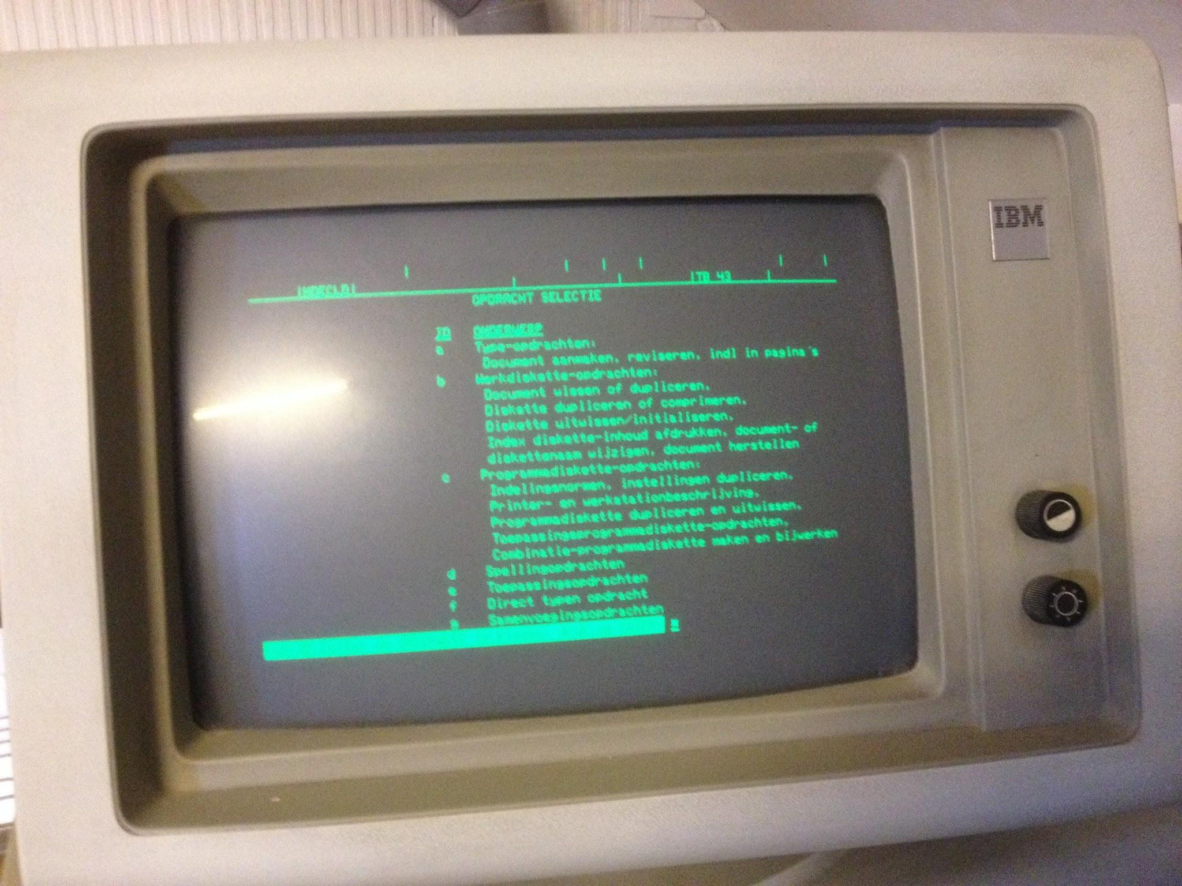
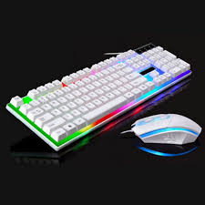
A Functional View of the Hardware
Internet
CPU
Input devices
Output Devices
Cache
RAM
Hard Disk
Memory
In addition:
Operating System
GPUs
Parallel Computers
External Memory

Slide 15
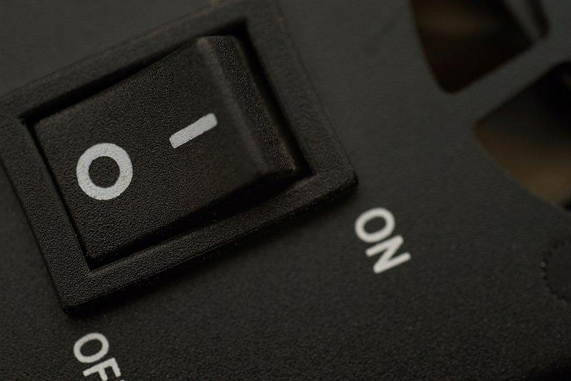
How can we communicate with a computer?
A computer is made of many “small” circuits, each of them carries a piece of information in a digital form:
Digital means “binary”, we have two states, on or off
On/Off can be regarded like letters of an alphabet (the only two letters, actually).
Let’s call these letters “0” and “1”
Can we represent any number only with two “symbols”?
Yes, it is enough to represent numbers in a base-2 framework.
Base-10 (we have 10 fingers):
Ten “letters”: 0,1,2,3,4,5,6,7,8,9
Positional notation

Slide 16




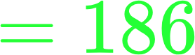
3
7
2
0
5
We can work similarly with any basis, for instance basis 2:
2 letters: 0,1
Positional notation
1
0
1
1
1
0
1
0
(in decimal notation)

Slide 17
So, we can represent integer numbers, provided we have enough switches/cells.
From now on, each cell is called “bit”. 8 bits form a “byte”.
A 64-bit system (most likely, your PC) is a system where each “word” consists of 64 bits.
Larger is the number of bits, and more precise your system is when representing numbers.
Number representation will be covered in detail in MATH315. You will see that also real numbers can be represented (many of them).
Negative numbers can be represented by reserving one bit for the sign:
0 = positive, 1 = negative
Number ok. What about real words?
The key concept is still the “position” of the bits: some bits can be reserved to “keywords”.

Slide 18
Special portions of the computer are dedicated to have bits for instructions.
Each instructions is encoded as a sequence of 0s and 1s.
The computer is organized as follows (simplified):
Address | Memory (bytes)
0(0)
1(1)
2(10)
3(11)
4(100)
5(101)
Program Counter
Action Address
Instruction
Registers
Math Unit

Slide 19

EXAMPLE
A=21 # set a certain cell of memory (say 1) to the value 21
B=433 # set a certain cell of memory (say 4) to the value 433
C=A+B #expand
fetch the value in address 1 to the register R0
fetch the value in address 4 to the register R1
add the content of R0 and R1 and put the result in R3
store R3 in a memory address (say 5) (the user will call it C)
Each action (highlighted in green) can be encoded as a sequence of 0 and 1 in the Instruction register (Action part).
The encoded sequence of 0 and 1 is called machine language.
WAIT! DO WE NEED TO WRITE IN MACHINE LANGUAGE?

Slide 20
NO!
We have programs that can translate our instructions for us.
So, we can write in a language and this will be translated in binary notation.
Types of Languages:
LOW-LEVEL:
“Assembly” is the closest version to the binary notation. The programmer works in a hardware-specific setting.
Action on registers must be taken care of (as in the previous example)
HIGH-LEVEL:
These languages are much closer to “human” communications. The “parser” is much more complicated, but it takes care of the hardware-specific features.

Slide 21
Two Types of High-level Languages
COMPILED
The parser is done my a program called “compiler” that creates an “executable” from your code. The code is optimized for the hardware.
Examples: C, C++, ForTran family, Pascal,...
Source Code
Compiler
Executable
Inputs
Run
Outputs

Slide 22
PARSED or INTERPRETED
Each instruction is converted on the go by the environment (sometimes written in a compiled language).
Examples: Matlab, Basic, Python (with some explanation)
Source
Parse and Run
Output
Input
 | Pro | Con
Compiled | Faster | Portability
Interpreted | Flexible | Slower

Slide 23
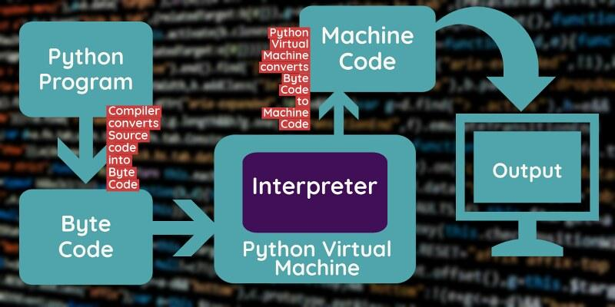
To be more precise, Python has a more complicated functionality, base on an intermediate platform-independent stage called byte code.
This allows to have some advantages of compiled languages.

Slide 24
Assignments
Look at these slides: they will help you in the future
Talk to your computer and prepare it for the Lab tomorrow
Verify that Python3 is installed on your computer, in case, install it (easy)
Read Chapter 1

